Slide 1
CSE291- Introduction to Software Engineering (FALL 2022)
Lecture 6
Requirement Engineering

Slide 2
Outline
Software Requirements
Types of Requirements
Role of Requirement
Stakeholders

Slide 3
Requirements
IEEE Standard 729 defines it as
“A condition or capability needed by a user to solve a problem or achieve an objective”
“A condition or capability that must be met or possessed by a system...to satisfy a contract, standard, specification, or other formally imposed document”

Slide 4
Software Requirements and Requirement Engineering
The requirements for a system
are the descriptions of the services provided by the system and its operational constraints.
These requirements reflect the
needs of customers for a system that helps to solve some problem such as controlling a device, placing an order or finding information.
“The process of finding out, analysing, documenting and checking these services and constraints is called requirements engineering (RE)”

Slide 5
Why Requirements?
System customers
specify the requirements and read them to check if they meet their needs.
Project managers
Use the requirements document to plan a bid for system and to plan the system development process.
System engineers
Use the requirements to understand what system is to be developed.

Slide 6
Why Requirements? (Contd..)
System test engineers
Use the requirements to develop validation tests for the system.
System maintenance engineers
Use the requirements to help understand the system and the relationships between its parts.

Slide 7
Role of Requirements
Project
Planning
Construction
Process
Project
Tracking
Software
Requirements
User
Documentation
Change
Control
System
Testing

Slide 8
Why requirement engineering is important
A survey on 8000 software projects
Most of the projects failed due to incomplete requirements
Cost to fix software errors
Requirements | 1.0
Design | 5.0
code | 10.0
Testing | 30.0

Slide 9
Different Levels Of Abstraction
User requirements
are statements, in a natural language plus diagrams, of what services the system is expected to provide and the constraints under which it must operate.
System requirements
System requirements set out the system’s functions, services and operational constraints in detail.
The system requirements document (sometimes called a functional specification) should be define exactly what is to be implemented.
It may be part of the contract between the system buyer and the software developers.

Slide 10
Example
User requirement: The library system should provide a way to allow a student to borrow a book from the library.
System requirement: The library system should provide a withdraw interaction that allows a student to withdraw a book given the isbn and copy number of the book to be withdrawn.
The interaction fails if: the book is already withdrawn, the book is not in the library's collection, the student has already withdrawn 5 books, the student owes more than $5, the book is on hold by someone else. Otherwise…(To be completed)

Slide 11
Types Of Requirements
Business Requirements
These are used to state the high-level business objectives of the organization or customer requesting the system or product.
They are used to document main system features and functionalities without going into their nitty-gritty details.
They are captured in a document describing the project vision and scope.

Slide 12
Types Of Requirements
Software system requirements are often classified as
Functional requirements
Non-functional requirements

Slide 13
Functional Requirements
These are statements of services the system should provide.
Services the system should provide.
How the system should react to particular input.
How the system should behave in a particular situations.
or
What the system should not do

Slide 14
Non-functional Requirements (NFR’s)
These are constraints on the services or functions offered by the system.
They include timing constraints, constraints on the development process and constraints imposed by standards.
Non-functional requirements often apply to the system as a whole. They do not usually just apply to individual system features or services.

Slide 15
Types of NFR’s

Slide 16
Types of NFR’s (Contd..)
Product requirements
Requirements which specify that the delivered product must behave in a particular way.
e.g. execution speed, reliability, Usability, etc.
Organizational requirements
Requirements which are a consequence of organizational policies and procedures in the customer’s and developer's organization.
External requirements
Requirements which arise from factors which are external to the system and its development process
e.g. legislative requirements, etc.

Slide 17
Types of NFR’s (Contd..)
Reliability Requirements:
Reliability requirements deal with the failure to provide service.
Example :
The failure frequency of a heart-monitoring unit that will operate in a hospital’s intensive care ward is required to be less than one in 20 years. Its heart attack detection function is required to have a failure rate of less than one per million cases.

Slide 18
Types of NFR’s (Contd..)
Efficiency Requirements:
Deals with the hardware resources needed to perform the functions of the software.
The main hardware resources to be considered are the computer’s
processing capabilities (measured in MIPS – million instructions per second, MHz or megahertz etc.), its data storage capability in terms of memory and disk capacity (measured in MBs – megabytes, GBs – gigabytes, etc.) and the data communication capability of the communication lines (usually measured in KBPS – kilobits per second., etc)
The requirements may include the maximum values at which the hardware resources will be applied in the developed software system.

Slide 19
Types of NFR’s (Contd..)
Portability Requirements:
Portability requirements tend to the adaptation of a software system to other environments consisting of different hardware, different operating systems, and so forth.
Interoperability Requirements:
Interoperability describes the extent to which systems and devices can exchange data, and interpret that shared data.
For two systems to be interoperable, they must be able to exchange data and present that data such that it can be understood by a user

Slide 20
Types of NFR’s (Contd..)
Integrity – deal with system security that prevent unauthorized persons access.
Usability – deals with the scope of staff resources needed to train new employees and to operate the software system.

Slide 21
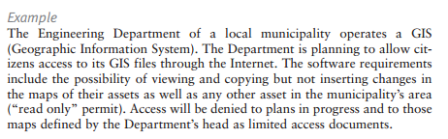
Integrity

Slide 22
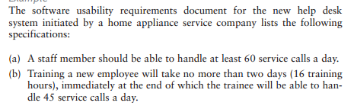
Usability

Slide 23
Example: A Word Processor
Let us now look at an example to understand the difference between these different types of requirements.
Let us assume that we have a word-processing system that does not have a spell checker. In order to be able to sell the product, it is determined that it must have a spell checker

Slide 24
Contd..
Business Requirement could be stated as:
user will be able to correct spelling errors in a document efficiently. Hence, the Spell checker will be included as a feature in the product.
In the next step we need to describe what tasks must be included to accomplish the above-mentioned business requirement.
The resulting User Requirement could be as follows:
Finding spelling errors in the document and deciding whether to replace each misspelled word with one chosen from a list of suggested words. It is important to note that this requirement is written from a user’s perspective.

Slide 25
Contd..
After documenting the user’s perspective in the form of user requirements, we look at the system’s perspective:
what is the functionality provided by the system and how will it help the user to accomplish these tasks.
The functional requirement for the same user requirement could be written as follows:
The spell checker will find and highlight misspelled words.
It will then display a dialog box with suggested replacements.
The user will be allowed to select from the list of suggested replacements.
Upon selection it will replace the misspelled word with the selected word.

Slide 26
Contd..
Finally, a non-functional requirement of the system could require that it must be integrated into the existing word-processor that runs on windows platform

Slide 27
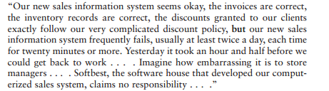
The Need For Comprehensive Software Non -Functional Requirements

Slide 28
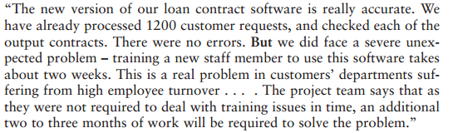
Contd..

Slide 29
Contd..
Mostly software projects satisfactorily fulfilled the basic requirements for correct calculations (correct inventory figures, correct average class’s score, correct loan interest, etc.)
Software projects suffered from poor performance in important areas such as maintenance, reliability, software reuse, or training.
Cause for the poor performance - lack of predefined requirements

Slide 30
Specifying the Requirements
Functional and nonfunctional requirements should be specified in such a way that they are understandable by system users who don’t have detailed technical knowledge.
These requirements are defined using natural language, tables and diagrams as these can be understood by all users.

Slide 31
Guidelines
While specifying or writing the requirements, following guidelines must be followed:
Invent a standard format and use it for all requirements.
Use language in a consistent way.
Avoid the use of computer jargons.
Separate functional and non-functional requirements.
Distinguish requirements priorities
Example: MoSCoW (Must, Shall, Could, Want/Will (no TBD))
Testable (write test cases)

Slide 32
Example – Identify the problem
If sales for current month are below target sales, then report is to be printed unless difference between target sales and actual sales is less than half of difference between target sales and actual sales in previous month, or if difference between target sales and actual sales for the current month is less than 5%.

Slide 33
Contd..
Problems:
Difficult to read
Ambiguity: sales and actual sales, 5% of what?
Incomplete: what if sales are above target sales?

Slide 34
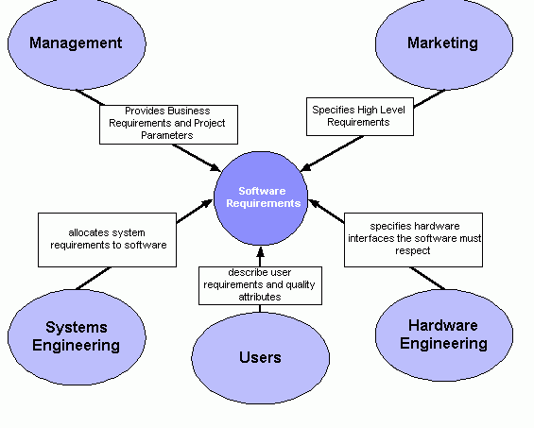
Stakeholders
Stakeholders are different people who would be interested in the software.

Slide 35
Chapter Reading
Chapter 4, Requirement Engineering,
Software Engineering by Ian Sommerville

